Slide 1



Hello and Welcome to
AI Camp

Slide 2
Unsupervised Learning
KALACHE Rachid Abdelghafour
SOAi Co-lead
Big Data Student at USTHB

Slide 3

Machine Learning
Machine learning
Supervised
Unsupervised
Classification
Regression
Clustering
Dimensionality Reduction

Slide 4
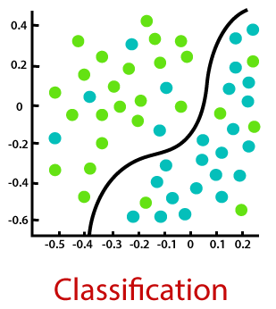
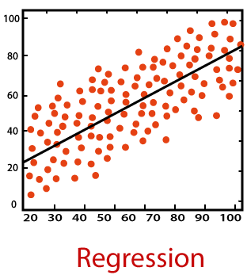
Supervised Learning

Slide 5
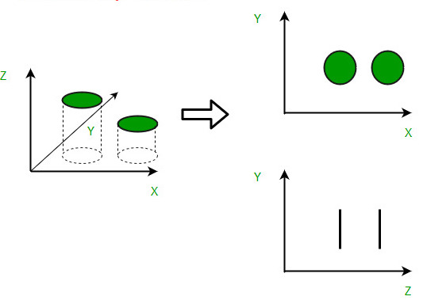
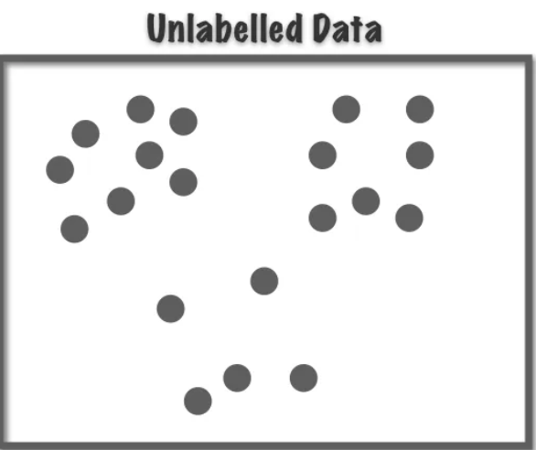
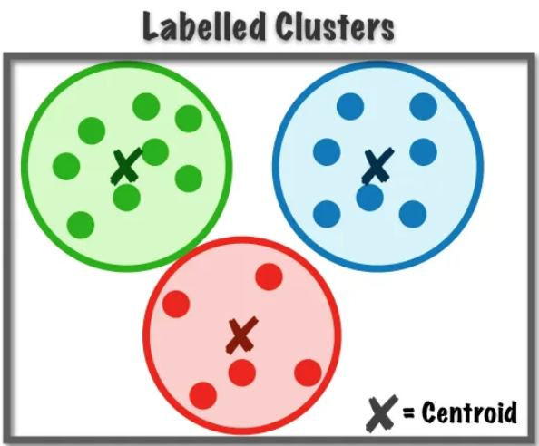
Unsupervised Learning
Dimensionality Reduction
Clustering

Slide 6
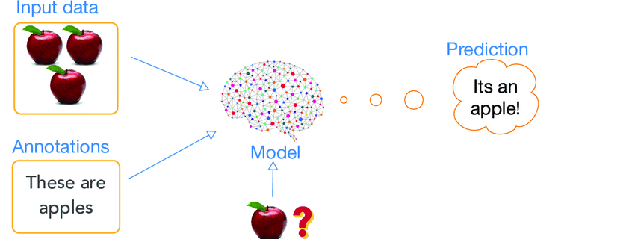
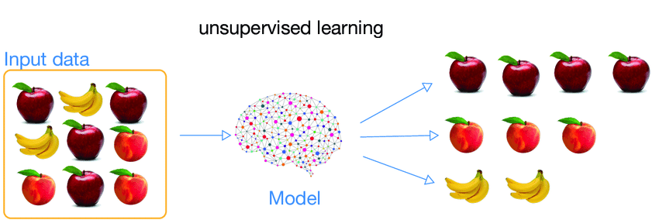
Supervised Vs Unsupervised
Supervised
Unsupervised

Slide 7


Clustering Algorithms
K-Means Clustering
2) DBScan Clustering

Slide 8
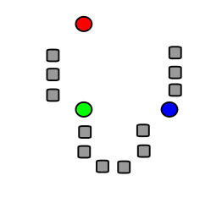
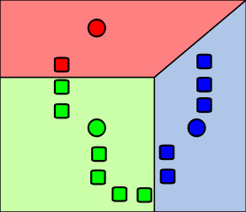
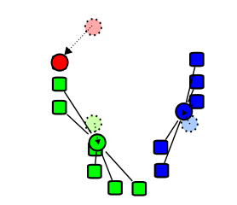
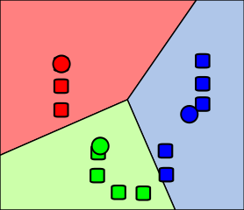
K-Means Clustering
Etape 1
Etape 2
Etape 3
Etape 4
Select random K points or centroids (K is hyperparameter)
Assign each data point to its nearest centroid.
Update centroids based on the mean of assigned data points.
Steps 2 and 3 are repeated until convergence has been reached

Slide 9

K-means Example

Slide 10

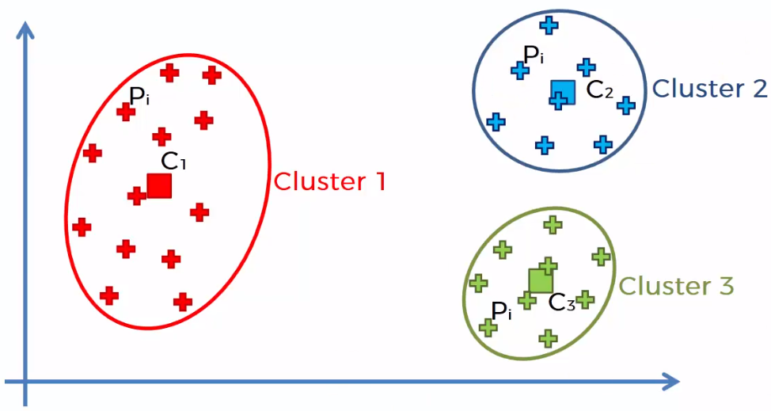
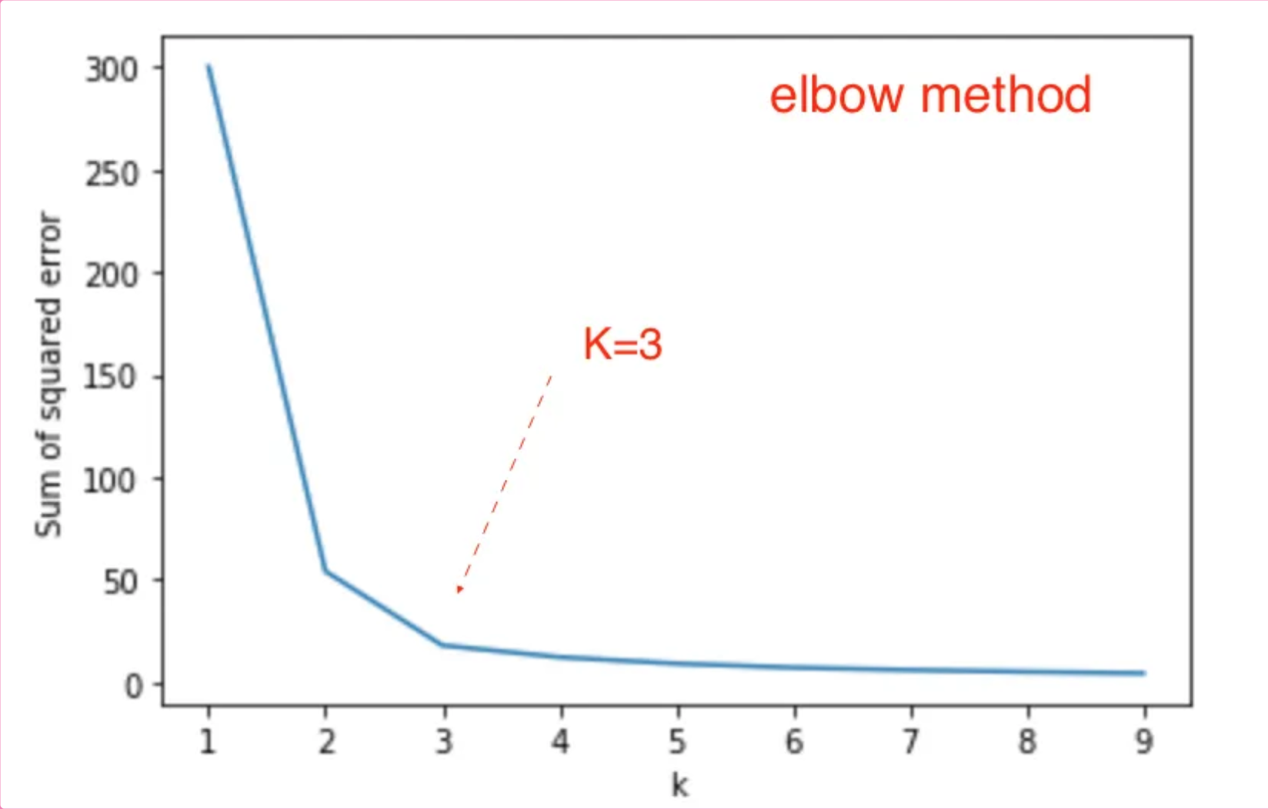
Elbow method:
(How to choose “K” in K-means)

Slide 11
Coding
Notebook: k_mean+dbscan.ipynb

Slide 12
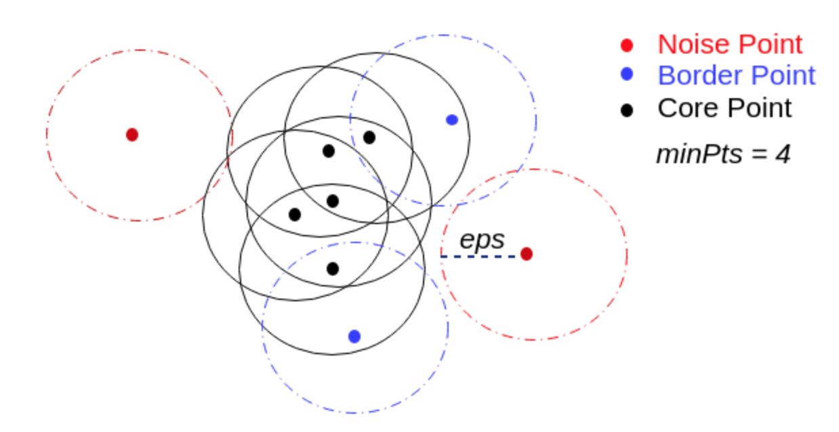
2) DBScan Clustering
DBScan parameters:
min samples
eps

Slide 13
DBScan Demo
https://www.naftaliharris.com/blog/visualizing-dbscan-clustering/

Slide 14
Coding
Notebook: k_mean+dbscan.ipynb

Slide 15
Dimensionality Reduction
PCA (Principal Component Analysis)

Slide 16
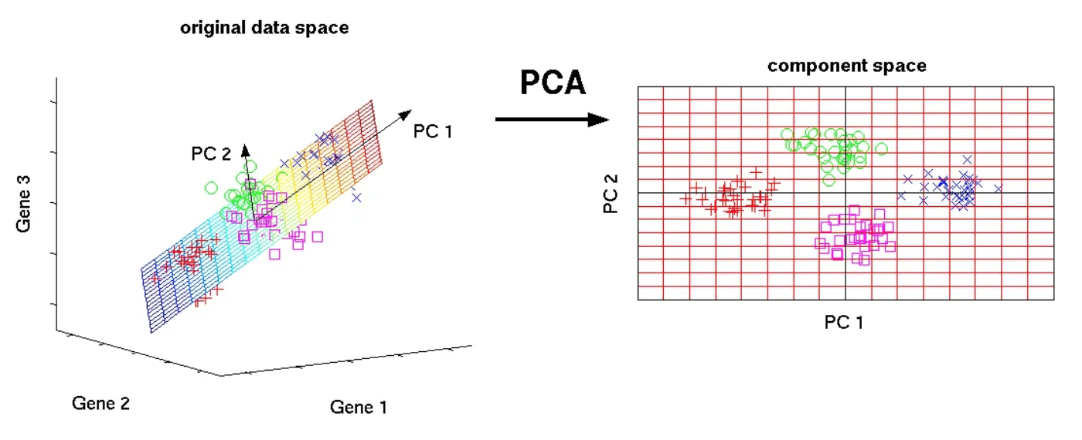
PCA (Principal Component Analysis)

Slide 17
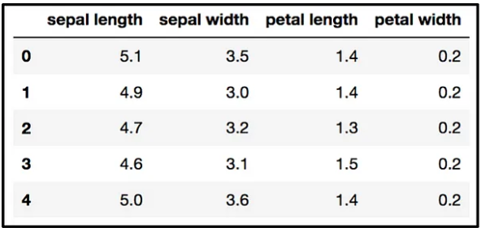
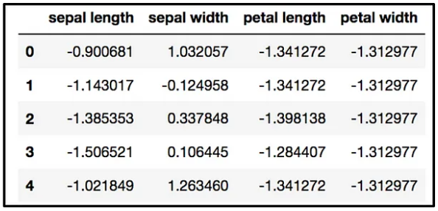
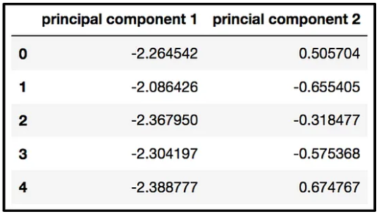
PCA Example
From 4 dimensions to 2 dimensions
original data
after Standard Scale
after using PCA

Slide 18
Coding
Notebook:
PCA-hand_digits(classification).ipynb
PCA-iris(classification).ipynb

Slide 19
Applying all the workshop algorithm:
k_means+dbscan+pca-iris_dataset.ipynb

Slide 20
Thank you for attending
any questions ?

Slide 22


Slide 24
Thank you for attending
any questions ?

